Slide 1
ESTP
Process Flow

Slide 2
Activities of NMMU Login
Fixing financial year wise targets for the states.
Adding new trades in ESTP.
Adding new courses.
Adding curriculum for the course.
Finalization of institutes and creating user credentials for institute.

Slide 3
Activities of NMMU Login
a) Permission for the institutes to conduct training at
different states.
b) Attaching courses to institutes.
6) Finalization of Certifying agencies and creating user credentials for Certifying agencies.
a) Permission for the Certifying agencies to conduct assessments for the different states.
b) Entry of Applications received by NMMU.

Slide 4
Activities of SULM Login
7) Skill Gap Entry.
8)Fixing financial year wise targets for the ULB’s .
9) Fixing trade wise target for the institutes.
10) Adding new trades by state, if it is not in NMMU
list.
(ESTP -> Add/Edit Trade)
11) Finalization of Certifying agency and creating user
credentials for Certifying agencies identified by the state,
if it is not created by NMMU.
(ESTP -> Certifying Agency -> Add Certifying Agency)

Slide 5
Activities of SULM Login
12) Adding new courses for their state, if it is not in
NMMU list, SULM can assign CA to the courses which is
created by them/NMMU.
(ESTP -> Course -> Add Course)
13) Adding curriculum for the course.
14) Finalization of institutes and creating user credentials for
institutes, if it is not created by NMMU.
a) Attaching courses to institutes is necessary.
(ESTP -> Institute -> Attaching courses to institutes)
15) Entry of Applications received by SMMU.
16) Creation of User credentials for the ULB.

Slide 6
Activities of ULB Login
17) Entry of Applications received by ULB.
(ESTP -> Application -> Add Application)
18) Selection of Applicants for the training program and
forwarding the applications to the training center along
with the computer generated letter to the applicant.
(ESTP->Forward to Training Center->Forwarding
Application to Training Center)
19) Adding new institutes if needed.

Slide 7
Activities of ULB Login
20) a. Add the Banks/ Branches of the Bank in their city.
(Admin -> Bank Branch Details -> Add Bank Branch)
b. Adding the ULB account details
21) Payment Release to institute.
(Releases -> Release to institute -> Payment release to
institute)
22) Payment Release to CA.
(Releases -> Payment Release to CA)
23) Profile Updation of the ULB.
24) Sending SMS regarding training Program to all the
participant of the training program.

Slide 8
Activities of INSTITUTE Login
25) Entry of Training Center details and the creation of user
credential for the Training Center.
(Training Center -> Add Training Center)

Slide 9
Activities of TRAINING CENTER Login
26) Creation of batches.
(Batch -> Create Batch)
27) Entering the detailed information’s of applicants which was
forwarded by ULB, and adding to the applicants to the
batches and preparing computer generated call letter to the
applicants.
(Beneficiary -> Enter Beneficiary Details)
28) Rejection of beneficiaries from the training program before
closing of training program if demand arises.

Slide 10
Activities of TRAINING CENTER Login
29) Intimating ULB regarding the selection of candidates
through computer generated letter.
30) Marking attendance for the training programs twice a day.
(Training -> Attendance -> Add Attendance)
Closing of training programme
Forwarding the beneficiaries to CA for the certification.
Entry of placement and self employment details
Uploding Salary slips.

Slide 11
MILESTONE of ULB
31)Assigning Certifying agency for the batches, before closing
of training program by ULB is necessary.
(ESTP -> Assign CA to training)
32 Entry of ULB Bank account details.

Slide 12
MILESTONE of Training Center
33) Closing of training program after completion of training.
(Training -> Closing of Training)
34) Intimating CA for the assessment of the beneficiaries who
are successfully completed the training through computer
generated letter.
35) Forwarding beneficiaries to CA for Assessment.
(Training -> Forwarding the beneficiary to CA for
Assessment)

Slide 13
Activities of Certifying Agency Login
36)Entering the details of the assessor.
(Assessor -> Add/Edit Assessor)
37) Assign assessor to the completed training programs.
(Assessor -> Assign Assessor)
38) Entering the assessment details of the beneficiaries.
If the beneficiary is failed then, application send back to ULB to repeat the same process again.
(Assessment -> Assessment Details)

Slide 14
MILESTONE After CA Completion(Training center)
39) Entering placement details of the beneficiaries.
(Placement -> Placement Details -> Enter Placement details)
40) Uploading the salary slips of beneficiaries.
(Placement -> Salary Slip -> Upload salary slip)
41) Entering self employed details of the beneficiaries.
(Uploading the self declaration form)
(Placement -> Self Employee Details -> Insert self employee
details)

Slide 15
Report for NMMU
1.Average income of self and wage employment:
This report shows the average income of self and wage employment of the beneficiaries by state wise as well as by trade wise. This is a drill down report. When you select the ‘Type’ state wise, It shows the state wise report. By clicking the state name you can see ULB wise report.
The drill down report will be displayed as below:

Slide 16
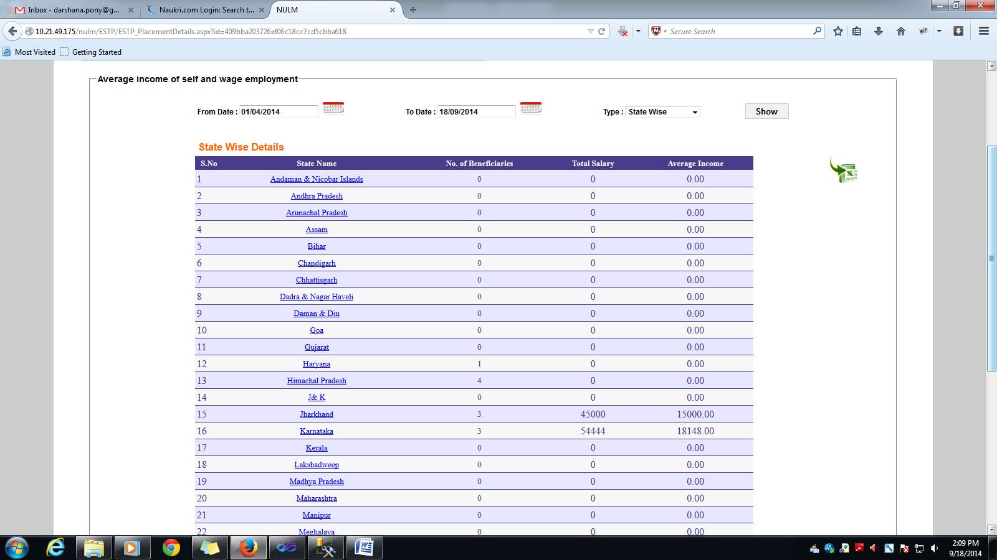
Report for NMMU
Click on state name to get ULB wise details

Slide 17
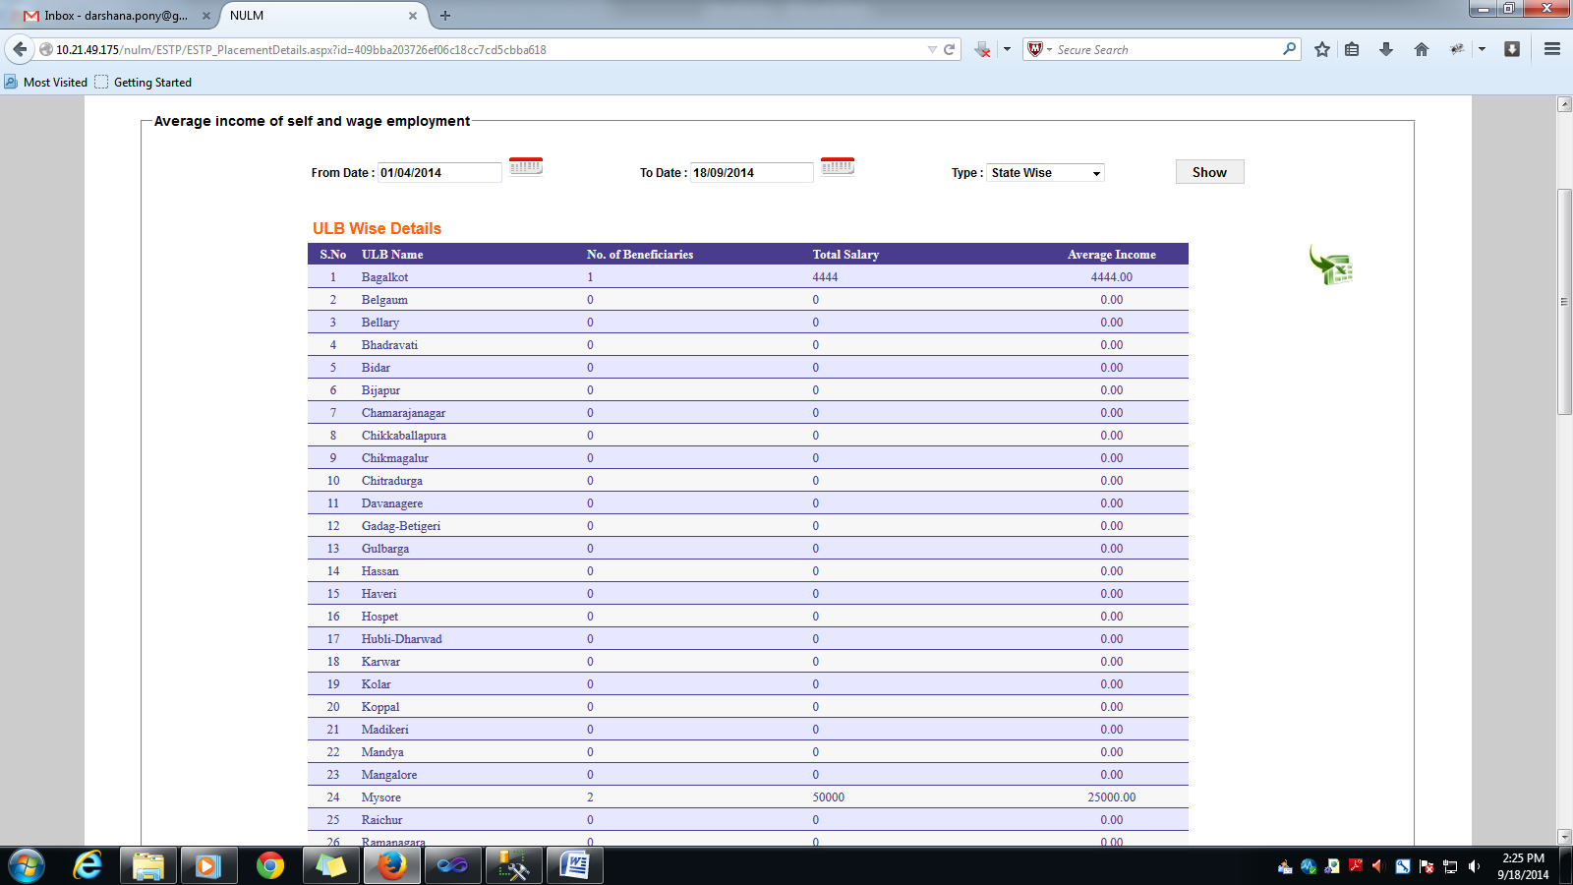
Report for NMMU
ULB wise report :

Slide 18
Report for NMMU
2.Monthly Progress Report For Employment through Skills Training and Placement:
This report shows the no. beneficiaries trained in a month, no. of beneficiaries received Certificate ,no. of candidates placed in employment and no. of candidates self-employed and empanelment details and also display the total amount disbursed for STPs and CAs.
3.Beneficiary Details State Wise:
This report shows the trade wise beneficiaries in a particular state for a particular financial year. This report is available for SMMU and ULB.

Slide 19
Report for NMMU
4.Certifying Agency Report Beneficiary wise:
This report shows the no of beneficiaries certified by different CA’s in a particular financial year. This is a drill down report. By clicking on CA name, the list of training programs certified by the selected CA will be displayed. By clicking on the no. of beneficiaries the beneficiary details will be displayed. This report is available for SMMU and ULB.
5.Beneficiary List Year wise:
This report shows the state wise, ULB wise beneficiaries for a particular financial year. It shows all the beneficiaries detail those who are completed the training program as well as in progress. This report is available for SMMU and ULB.

Slide 20
Report for NMMU
6.Beneficiary List Institute/Year wise:
It shows the Institute wise list of beneficiaries trained in the training programme in a financial year. By clicking on Institute name, the list of training programmers conducted by the selected Institute will be displayed. By clicking on the no. of beneficiaries the beneficiary details will be displayed.
7.ESTP Report of Financial Allocation Vs Achievement:
It shows the state wise total financial allocation amount and total expenditure amount of ESTP and SEP for particular financial year. This is a drill down report. By clicking on state name you can see the ULB wise details of allocation report.

Slide 21
Report for NMMU
8.Beneficiaries Details Category Wise:
This report shows ULB wise and under the ULB the category wise beneficiaries trained in a particular period for a particular state. This is a drill down report. By clicking on the count of beneficiaries the beneficiary’s details will be displayed. This report is available for SMMU and ULB.
9.Beneficiaries Details Education wise:
This report shows ULB wise and under the ULB the Education wise beneficiaries trained in a particular period for a particular ststate. This is a drill down report. By clicking on the count of beneficiaries the beneficiary’s details will be displayed. This report is available for SMMU and ULB.

Slide 22
Report for NMMU
10.No. of Organizations Empanelled (Certifying Agencies):
This report shows the Certifying Agencies which are empanelled with NULM. This report shows the state wise empanelled CA’s as well as trade wise empanelled CA’s.
11.No. of Organizations Empanelled (STP):
This report shows the Training Institutes which are empanelled with NULM. This report shows the state wise empanelled Training Institutes as well as trade wise empanelled Training Institutes.

Slide 23
Report for NMMU
12. No. of Candidates Placed by Government vs. Private Institutes:
This report shows the state wise no. Beneficiaries placed in the private as well as in the Institutes after completion of training. This is a drill down report. By clicking on the count of beneficiaries the Institute wise details will be displayed. By clicking on the count of beneficiaries, the beneficiary’s details will be displayed.
13.Status of Letter of Intents:
This report shows the state wise the list of applications received from the general public for the particular period. This is a drill down report. By clicking on the count of applications the applicant’s details will be displayed.

Slide 24
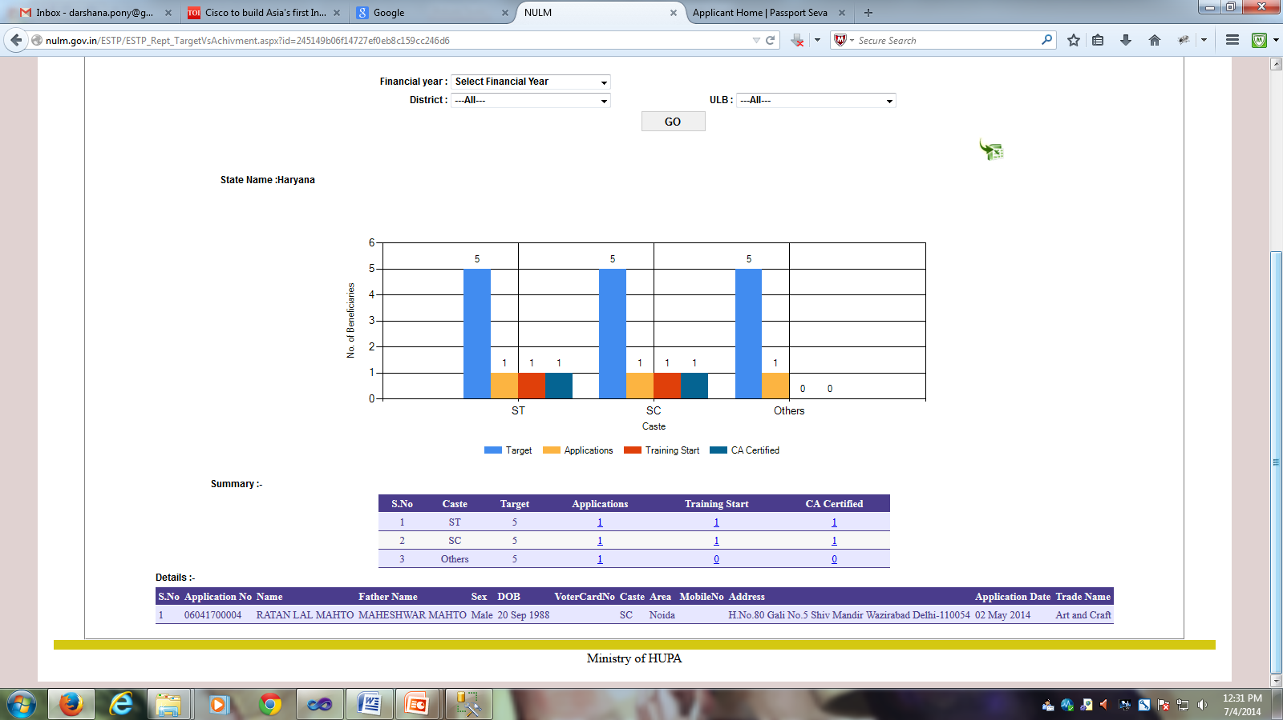
Graphical Report for NMMU
1.Target Vs Achievement Graphical Report:
This reports show the graphical analysis on the targets and achievement on a financial year. This report is available for SMMU & ULB.
Click on application, training and CA certified

Slide 25
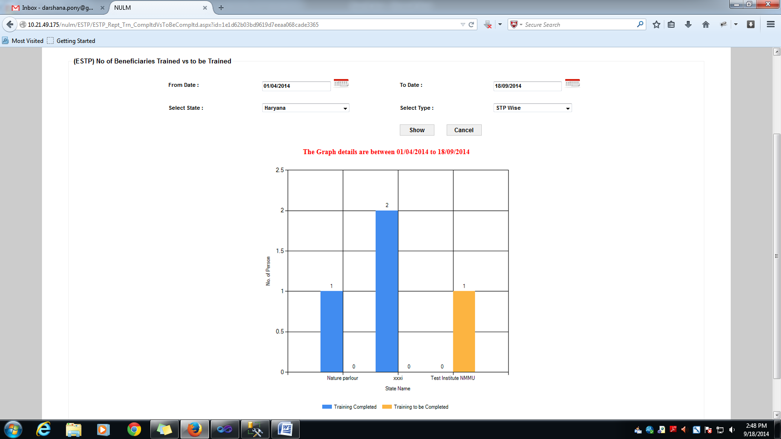
Graphical Report for NMMU
2.No. of beneficiaries trained vs. to be trained:
This reports show the comparative analysis on the no of beneficiaries to be trained and the no. of beneficiaries already trained on the particular period. This report is available for SMMU.
ESTP beneficiary graphically representation

Slide 26
Graphical Report for NMMU
3.No. of Beneficiaries Certified vs. to be Certified:
This reports show the comparative analysis on the no of beneficiaries to be certified and on the no. of beneficiaries certified on a particular period. This report is available for SMMU.
4.No. of Beneficiaries Placed vs. to be Placed:
This reports show the comparative analysis on the no. of beneficiaries to be placed and on the no. of beneficiaries placed on a particular period. This report is available for SMMU.

Slide 27
Graphical Report for NMMU
5.Monthly Beneficiary Progress Report:
It shows the progress of the ESTP Scheme in month wise for a particular financial year. This report is available for SMMU & ULB.
ESTP beneficiary progress line chart representation

Slide 28
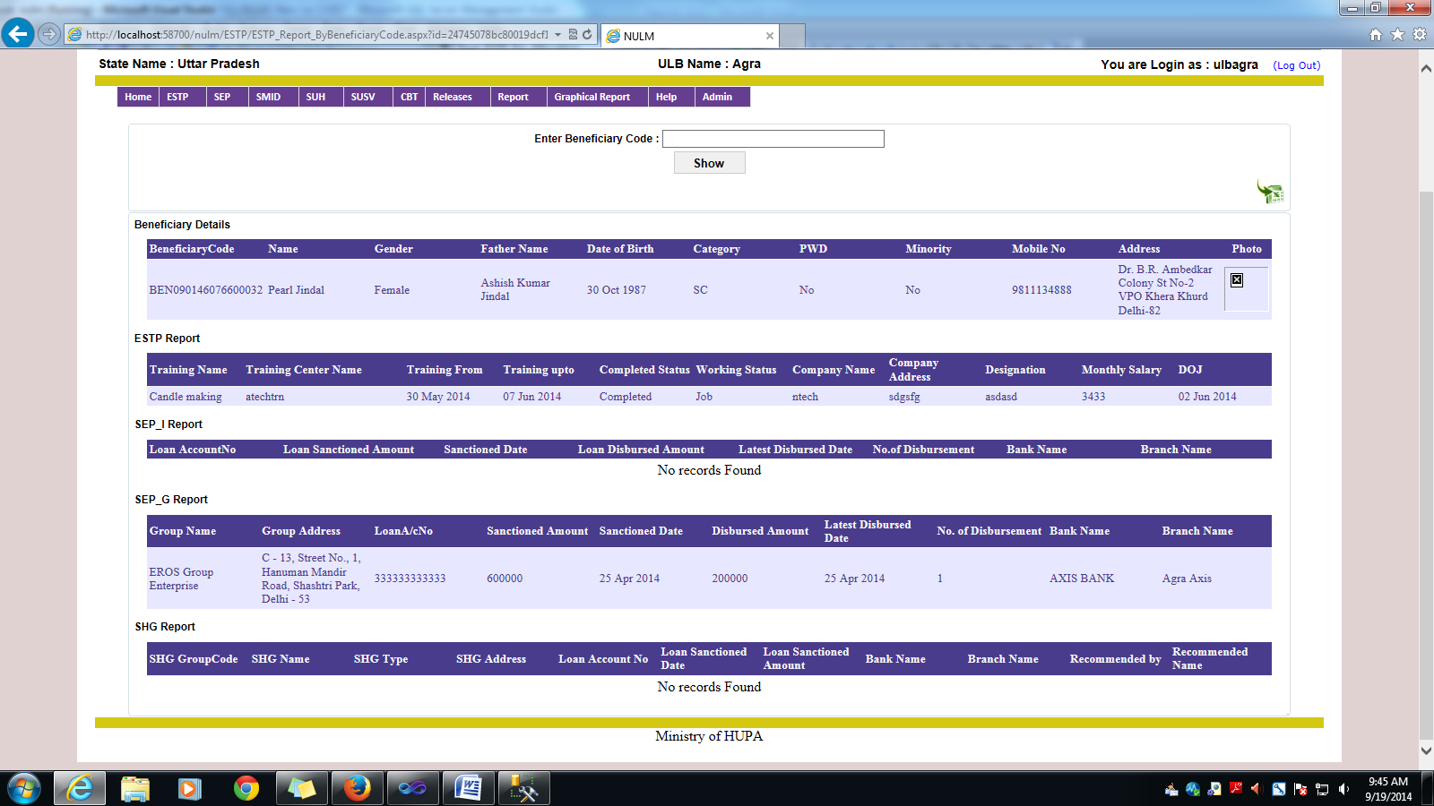
Report for ULB
1.Beneficiary Details:
This report shows the benefits obtained by a beneficiary in different components of NULM. By entering the beneficiary code, it will display the benefits optioned by that beneficiary in all the schemes of NULM.

Slide 29
Thanking you!

