Slide 1
Presentation on Angikaar Module and Houses Completion entry module.
M.Ezhil Arasu
Scientist –F
NIC

Slide 2
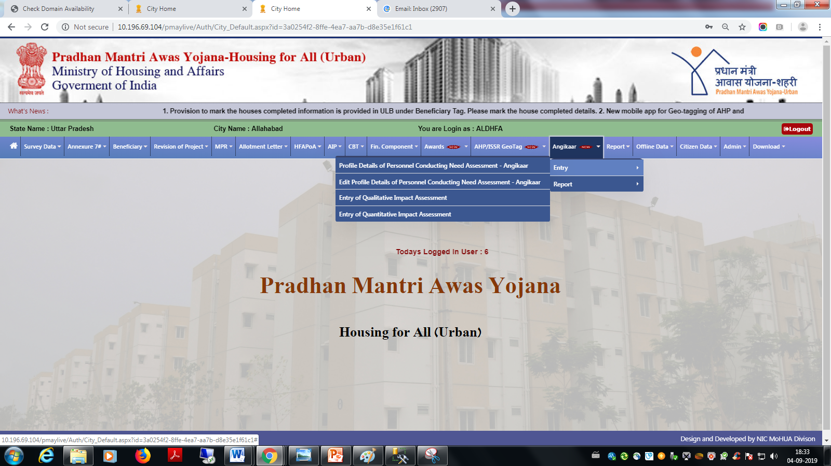
Angikaar
Provision is provided in the ULB login to enter all Angikaar resource person details like ARP, CO, CLTC, SLTC, Volunteer, Student etc

Slide 3
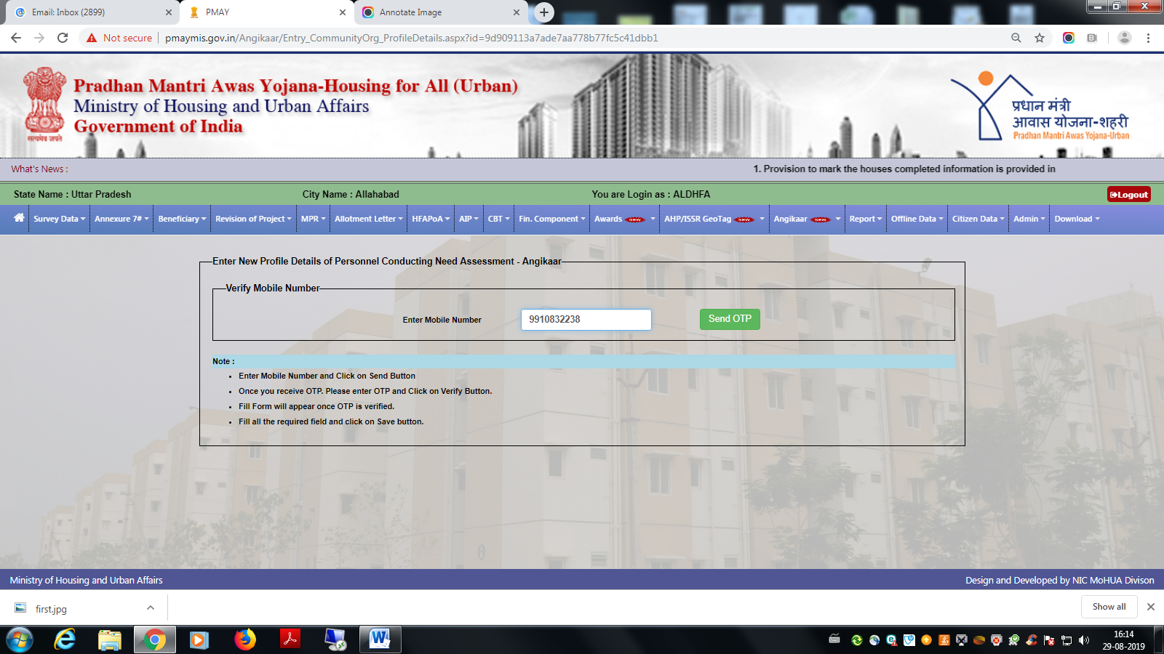
Angikaar ARP Entry
Under Angikaar tag , Under Entry tag please select ‘’Profile details of Personnel conducting Need Assessment’’
System checks the uniqueness of the mobile number

Slide 4
Angikaar ARP Entry

Slide 5
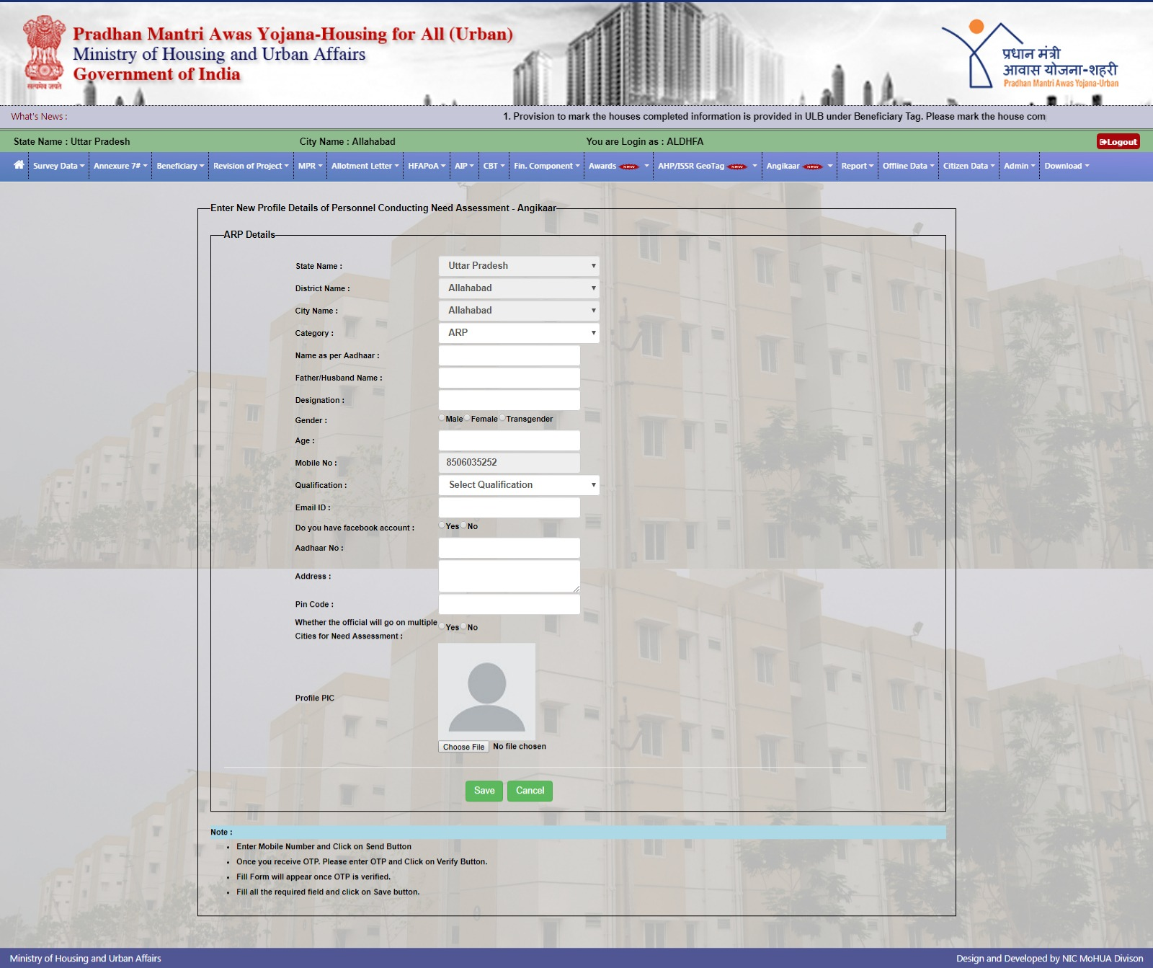
Angikaar ARP Entry
After the verification of OTP this screen appears

Slide 6
Angikaar ARP Entry
Aadhaar number is mandatory
System checks the uniqueness of the Aadhaar number
Name has to be entered as per the Aadhaar
Demographic Aadhaar authentication is incorporated. If it not matches then it gives error.
All the fields are mandatory
Image should be in JPG/JPEG format only and it should not exceed 100 kb
Officials are allowed for the maximum of 4 cities including home city.

Slide 7
Angikaar ARP Entry
After entering all the data if you click on save button , if there is no error then system gives the message that Record saved successfully along with ARP unique code.
For operating Angikaar Mobile app the entry of ARP is mandatory.

Slide 8
Angikaar Qualitative Impact Assessment
All the events conducted in their city has to be entered along with event image, video and event report.
Angikaar ARP Entry

Slide 9
Angikaar Quantitative Impact Assessment form
This is a one time entry. After completion of entire Angikaar programme these data have to be filled.
Water supply
Number of AHP and ISSR projects using recycled water.
Health
Number of beneficiaries that have received Health cards under Ayushman Bharat.
Ujjwala
Number of beneficiaries who have received LPG connections under Ujjwala.
Environment
Number of trees planted during the campaign
Number of of rain water harvesting and recharge structures in PMAY (U) houses/ projects
Energy Conservation:
Number of Solar Energy devices such as solar lighting for household purpose.
Number of PMAY(U) houses/ projects using LED lights
Solid Waste Management
Number of PMAY(U) households where waste is collected and where waste is segregated at source
Number of wet and dry dustbins beings used
Outreach:
Number of PMAY(U) beneficiaries outreached for awareness on schemes and services.
Number of people (non PMAY –U) outreached during for awareness on schemes and services in wards (BLC locations)

Slide 10
Angikaar Quantitative Impact Assessment form

Slide 11
Beneficiary house completion Details
The List of houses which are already completed has to be marked along with beneficiary latest mobile number and address
Existing address, mobile will populate automatically , if any changes then it has to modified.
Mobile number will be verified through OTP
Even the OTP verification is failed system allows to save the data
Any Residential address proof has to uploaded in the pdf or JPG format. Size should not exceed 600 kb.
Pin code and completion date are mandatory

Slide 12
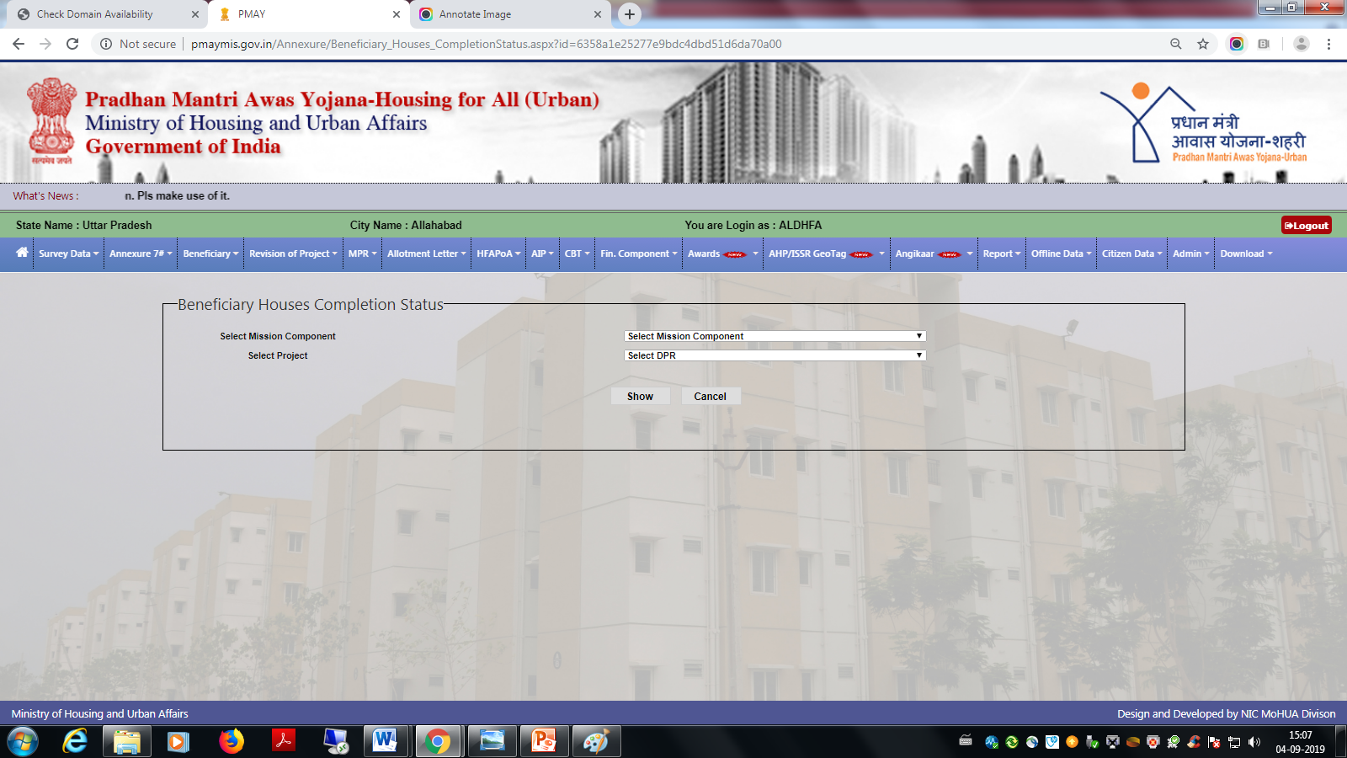
Beneficiary house completion Details
Provision is provided under Beneficiary Tag in ULB login
Select the Mission component and the Project and then press the Show button

Slide 13
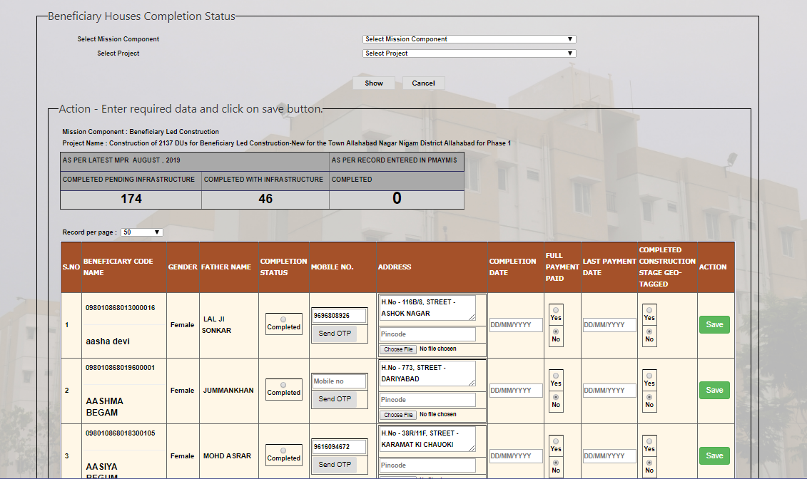
Beneficiary house completion Details

Slide 14
Beneficiary house completion Details
Data validations incorporated along with Latest MPR.
Total Completed house should not exceed the latest MPR
After the houses are marked as completed it will be available with state for approval.
If any house is marked wrongly, ULB may ask the State to reject and then correct house may marked as completed
For your simplicity the status of the submitted house will appear with different colour codes. Colour codes are mentioned on the bottom of the screen.
Provision is provided to modify the Geo-tagged information and full payment paid details after state approval.
Geo-tagged completion status entry is checked with NRSC information.

Slide 15
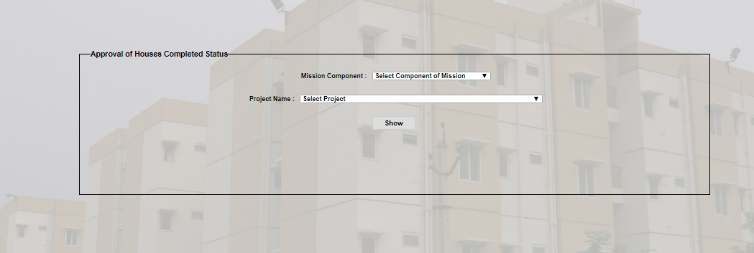
Beneficiary house completion Details
Approval of house completed details is available under Beneficiary tag in State login.
Select the Mission component and the project press the Show button

Slide 16
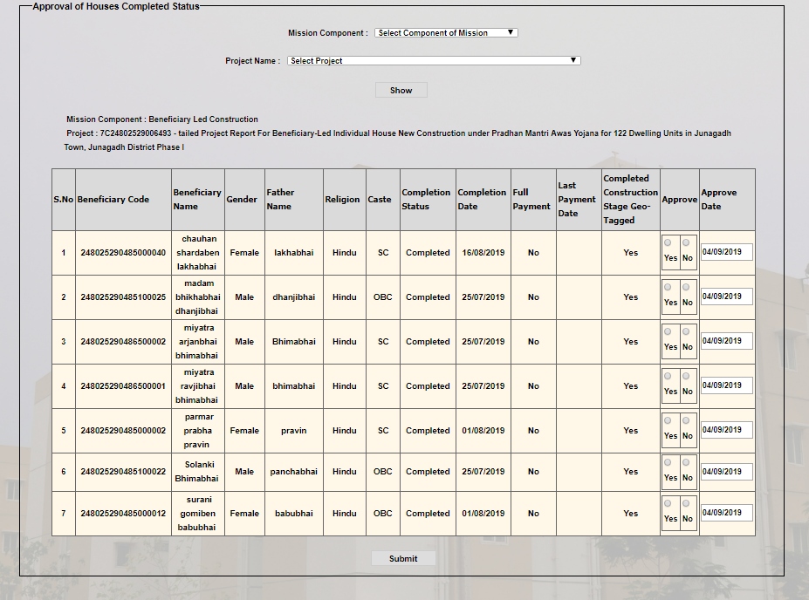
Approval of house completed
State has to approve individual houses. After taking decision click on submit button

Slide 17
Update Beneficiary House Completion Status
Provision of update beneficiary house completion status is available under Beneficiary tag in
ULB login. Select the Mission component and the project press the Show button

Slide 18
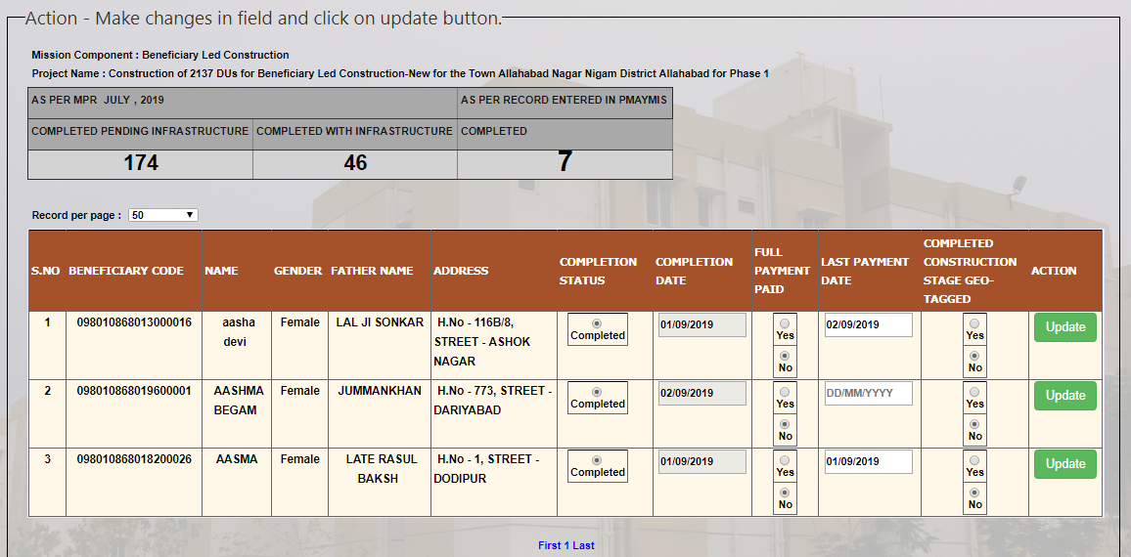
Update Beneficiary House Completion Status
You can change only Payment Details and Completed Construction Stage Geo-Tagged.
Changes from Yes to No is not allowed for Full Payment Paid and Geo-Tagged.
After changing click on Update button, It will reflect in State login for approval.

